Slide 1

The Battle of Neighborhoods: Coursera Capstone Project Looking for potential place(s) to open a new Korean restaurant in Kwun Tong District, Hong Kong.
Kimball Au

Slide 2
1. Introduction/Business Problem
The Korea-based company is planned to expand their business outside Korea and they are thinking of Hong Kong as the first place to open a restaurant.
However, the company is not familiar with how the other Korean restaurant are running in Hong Kong, therefore the objective of this project would be understanding the neighborhood of existing Korean restaurant in other districts of Hong Kong.

Slide 3

2. Data
There are 18 districts in Hong Kong, and the project would focus on understanding neighborhood of existing Korean restaurant in 17 districts of Hong Kong, excluding Kwun Tong District, where the place that the company targeted.
Data would be collected by using Foursquare API, including existing Korean restaurants in Hong Kong and neighborhood of where they located

Slide 4
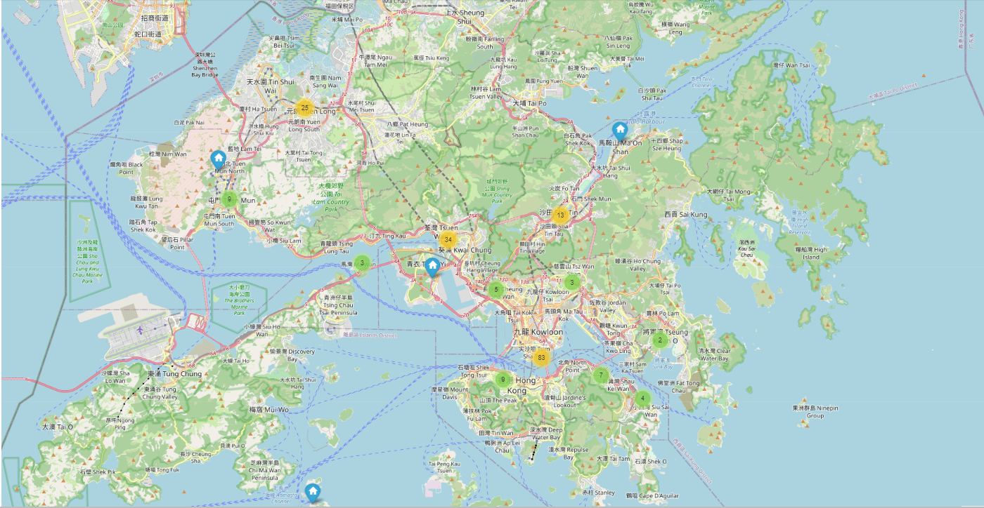
3. Methodology
Korean Restaurant in other 17 District

Slide 5
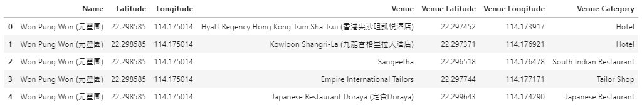
3. Methodology
The neighborhood of each Korean restaurant is collected using Foursquare API and stored in Padas Dataframe for further processing later.

Slide 6
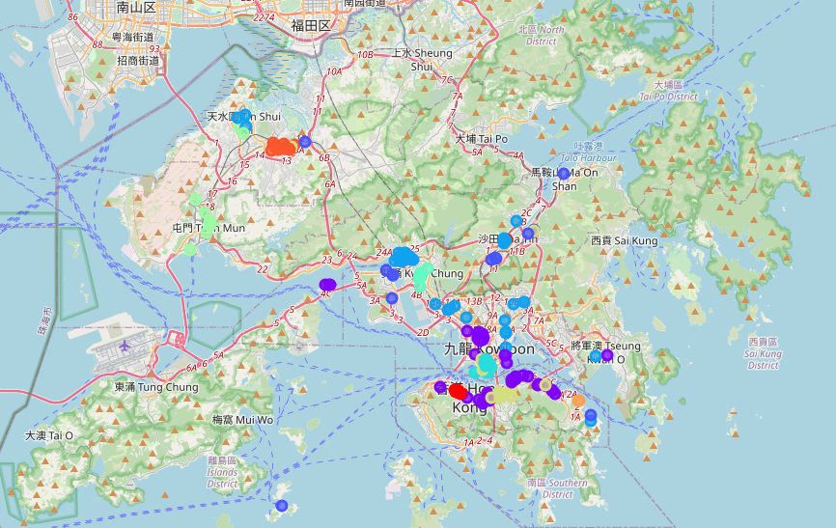
3. Methodology
K-Mean Clustering (k=10)

Slide 7
3. Methodology
The analysis would focus on the top 3 clusters containing more number of restaurant as we are focusing the neighborhoods of existing Korean restaurant in general
Cluster 3: Korean restaurants in the cluster mainly surrounded by Shopping Malls, Chinese and Fast Food restaurants.
Cluster 1: Korean restaurants in the cluster mainly surrounded by Hotels and Coffee Shops.
Cluster 7: Korean restaurants in the cluster mainly surrounded by Hotels and Japanese restaurants.

Slide 8
4. Results
The analysis on major cluster showing that Korean restaurants mainly located near the places attracting visitors and tourists, like shopping malls and hotels. In another dimension, Korean restaurant is also likely to be located near other Asian restaurants like Chinese and Japanese restaurants.
4 selected locations (APM, Megabox, Kwun Tong Promenade and Lei Yue Mun) seems also fit the general characteristics for Korean restaurant, in terms of characteristics of the neighborhood.

Slide 9
Discussion and Conclusion
During the analysis, it is recommended to include more district information to decide the final location for a new restaurant, like demographic data, rental cost and targeted age group.
Clustering allows this analysis to understanding where the existing Korean restaurants are located.
This analysis finds that Korean restaurants would generally locate in the place attracting visitors and tourists, like Shopping malls and Hotels, which would have potential high revenue as people would looking for restaurants after shopping and also where the tourists live. Korean restaurants would also likely locate near other Asian restaurant like Chinese and Japanese restaurants.

Slide 10
Thank You

